Slide 1




NEXT GEN EMPLOYABILITY PROGRAM
Creating a future-ready workforce
Team Members
College Name
Student Name :Andrew Nathan A
Student ID :311121104006
Loyola ICAM College of Engineering and Technology

Slide 2

CAPSTONE PROJECT SHOWCASE
Project Title
Music Web Application using Django Framework
Abstract | Problem Statement | Project Overview | Proposed Solution | Technology Used | Modelling & Results | Conclusion

Slide 3
Abstract
This project involves development of a music application using Django. This application will allow users to create accounts, manage music libraries and stream music. Key features include user authentication, a responsive user interface, secure file storage, and a dynamic music player interface. Additionally, the application will utilize Django's built-in ORM for database management and RESTful APIs for seamless integration with frontend technologies.
Source :

Slide 4
Problem Statement
Creation of Music Web Application using Django Framework
Source :

Slide 5
Project Overview
This project endeavors to craft a contemporary and intuitive music streaming application utilizing Django. It empowers users to establish personalized accounts, curate their music libraries, and indulge in uninterrupted streaming of beloved tracks. Highlighted features encompass robust user authentication, adaptable design catering to diverse devices, safeguarded file storage, and an effortless music player interface. Through harnessing Django's ORM and RESTful APIs, our aim is to furnish a dependable platform enriching the music listening journey for every user.
Source :

Slide 6
Proposed Solution
Our solution involves building a music streaming application using Django, integrating essential features like user authentication, music upload and management, and a responsive music player. We will implement secure file storage for user uploads and ensure compatibility across different devices through responsive design. The use of Django's ORM will facilitate efficient database management, while RESTful APIs will enable seamless communication with the frontend. Our aim is to create a streamlined and enjoyable music streaming experience for users, emphasizing simplicity and functionality.
.
Source :

Slide 7


Technology Used
Front-end
Back-end
Source :

Slide 8
Modelling & Results
In this project, we'll create a Django data model to manage users, music tracks, and playlists. We'll use Django's built-in ORM for storing and retrieving data efficiently. User authentication will be set up using Django's ready-made authentication system. On the frontend side, we'll design responsive templates using HTML, CSS, and JavaScript to ensure smooth user interaction. For playing music, we'll use Django's file handling features along with a customized music player interface.
Source :

Slide 9
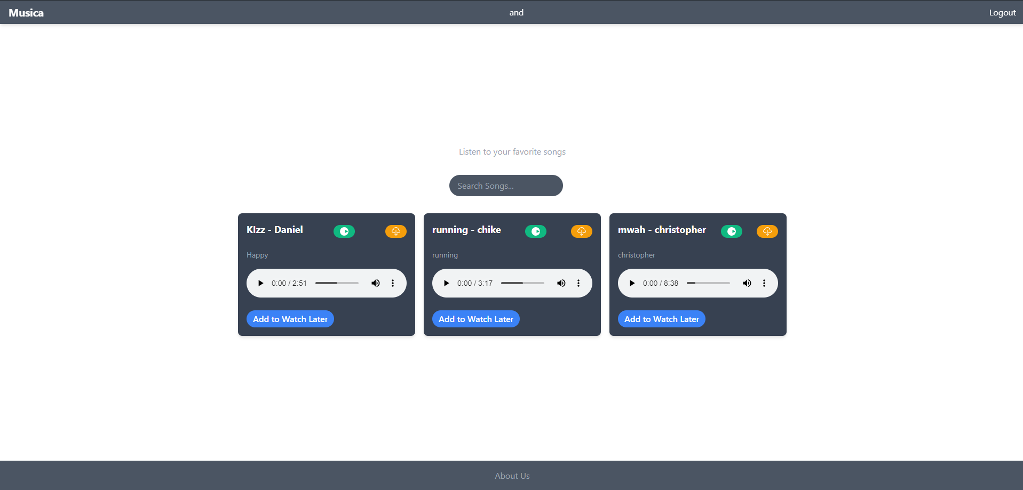
Homepage

Slide 10
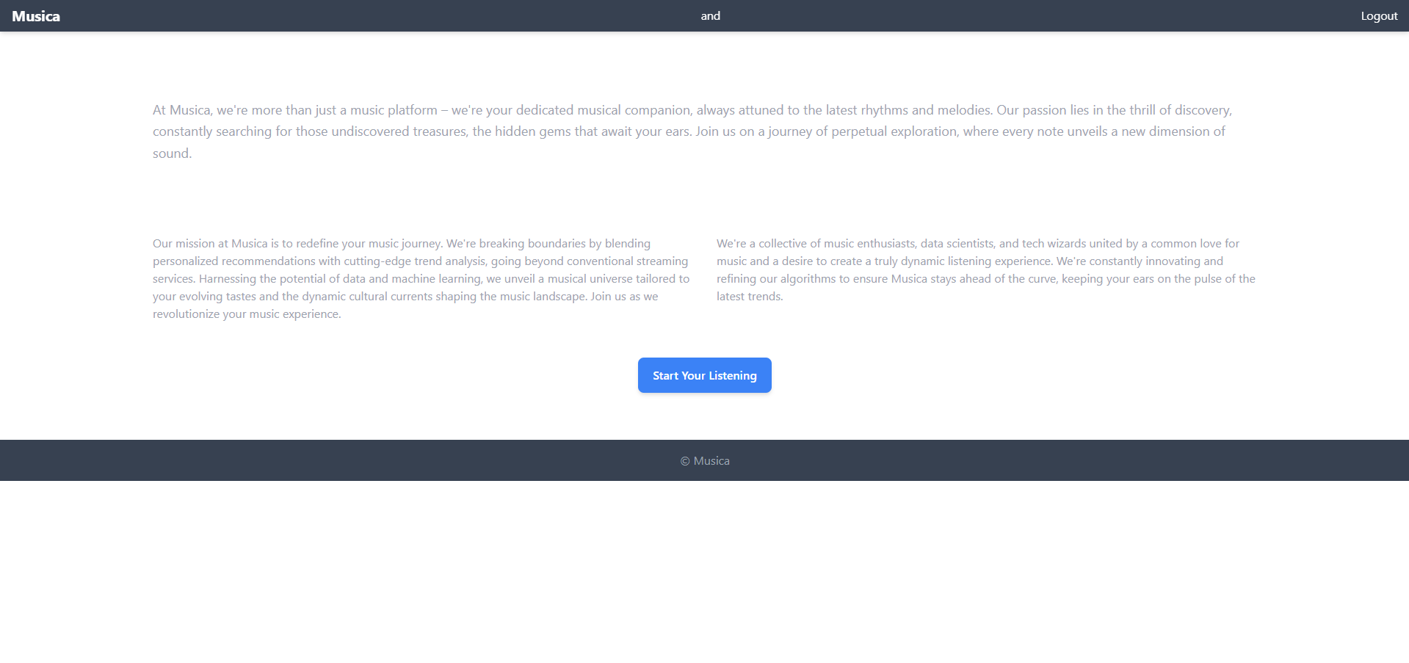
About-Us-Page

Slide 11
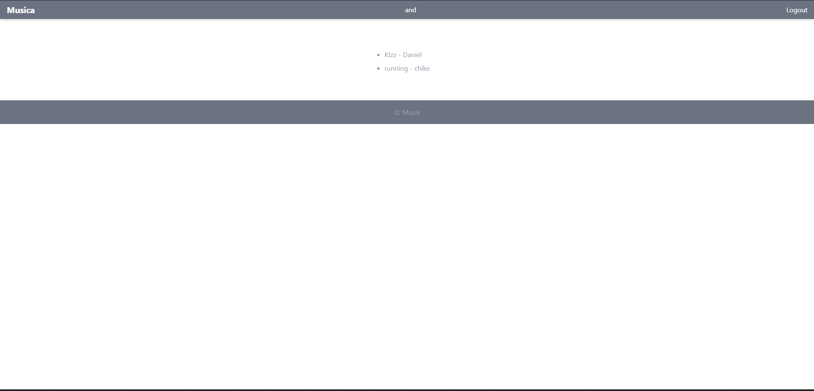
Playlist

Slide 12
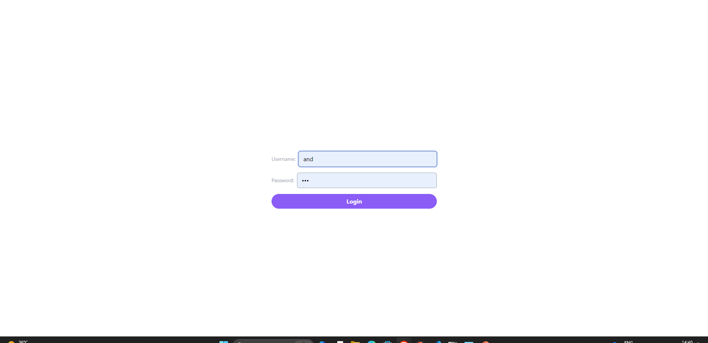
Login-Page

Slide 13
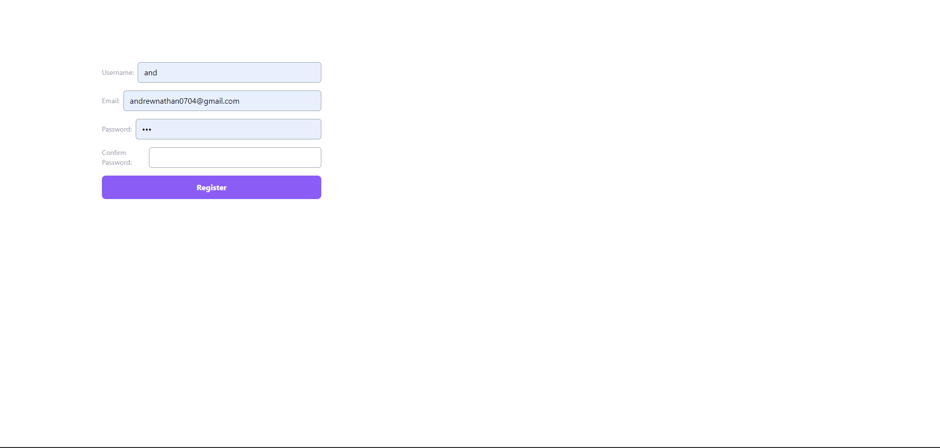
Register-Page

Slide 14
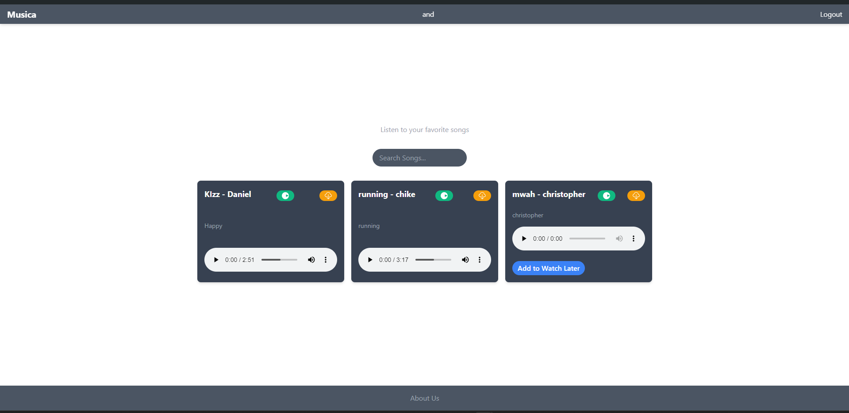
Home Page After login

Slide 15
Future Enhancements:
In the future, we could implement features such as personalized recommendations based on listening history, social sharing of playlists, integration with external music APIs for expanded content access, and support for offline playback. We could also enhance the user interface with more interactive elements. Continuous performance optimization and scalability improvements could also be done for growing user base.

Slide 16
Conclusion
In conclusion, this Django-based music streaming application presents a scalable and feature-rich platform for music enthusiasts. By leveraging Django's robust framework, I have developed a responsive and secure solution that prioritizes user experience. With planned future enhancements, we are committed to evolving this application to meet the dynamic demands of music streaming while maintaining a seamless and enjoyable experience for our users.
Source :

Slide 17
Thank You!
Notes:
Thank You !!

